Slide 1
STAT/CS187
Final Project:
Sleeping Separately
Huaye Yang, Halina Vercessi, and Matthew Mccarthy

Slide 2
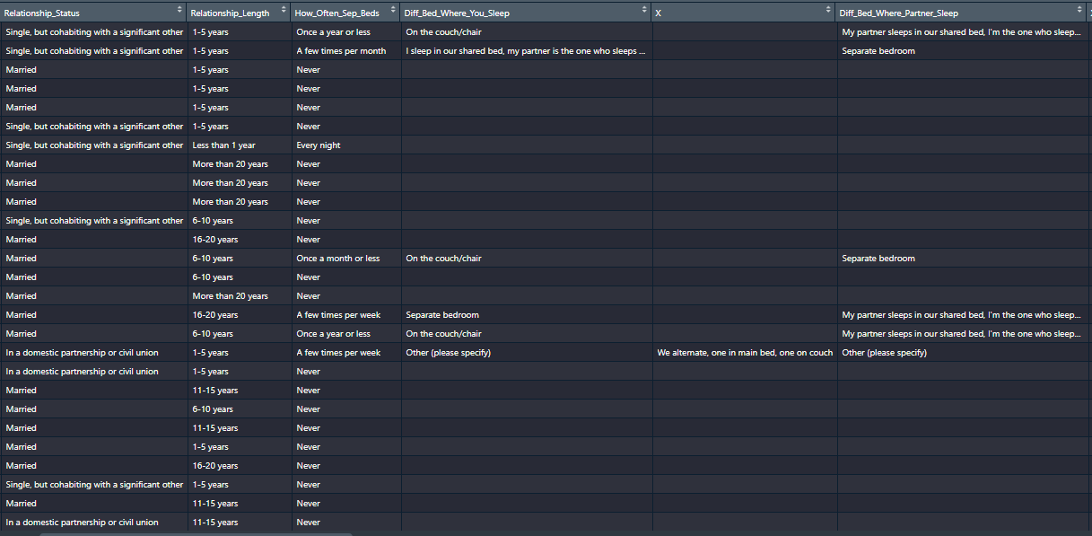
A quick look at the data:

Slide 3
The Dataset
Dataset involves how often couples sleep separately
What factors contribute to couples sleeping separately?
Why do couples sleep in separate beds?
Data is from survey created in 2014 by Mona Chalabi as research for an article for FiveThirtyEight (from ABC News)
The population from which this sample was drawn includes 1,057 American adults who were married, in a domestic partnership, in civil union or cohabiting with a significant other

Slide 4
Frequency Sleeping Separately: Relationship Length and Age

Slide 5
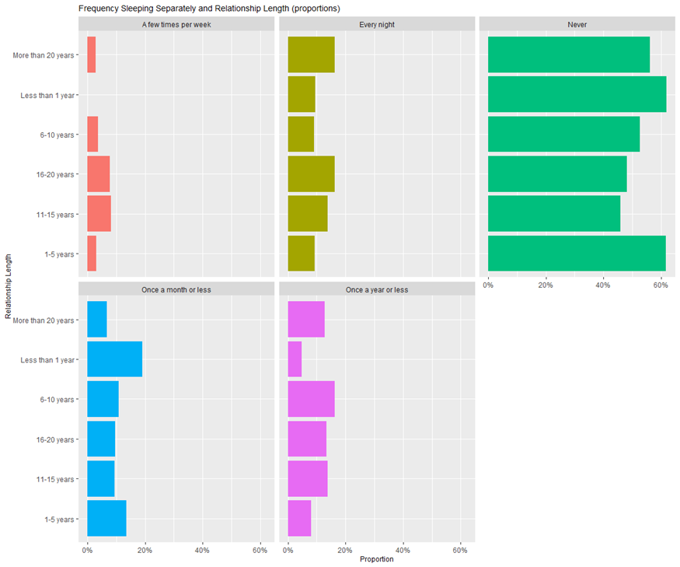

Slide 6
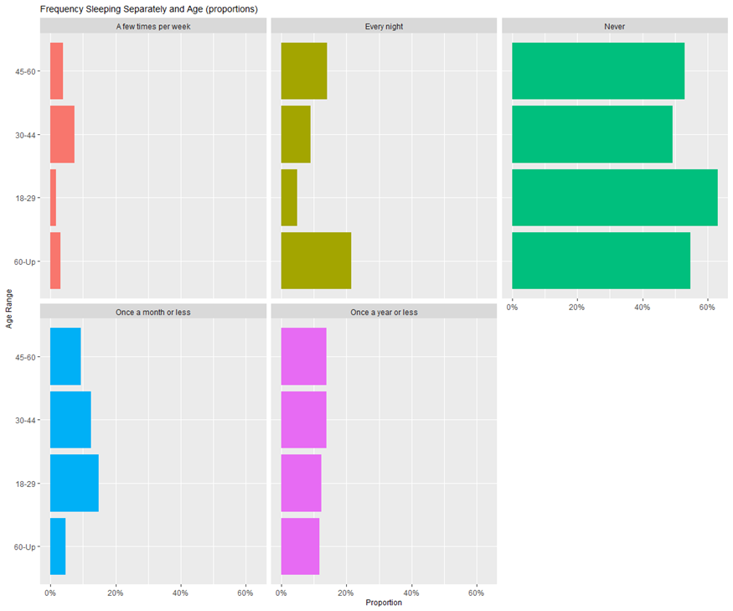

Slide 7
Frequency Sleeping Separately: Occupation and Income

Slide 8
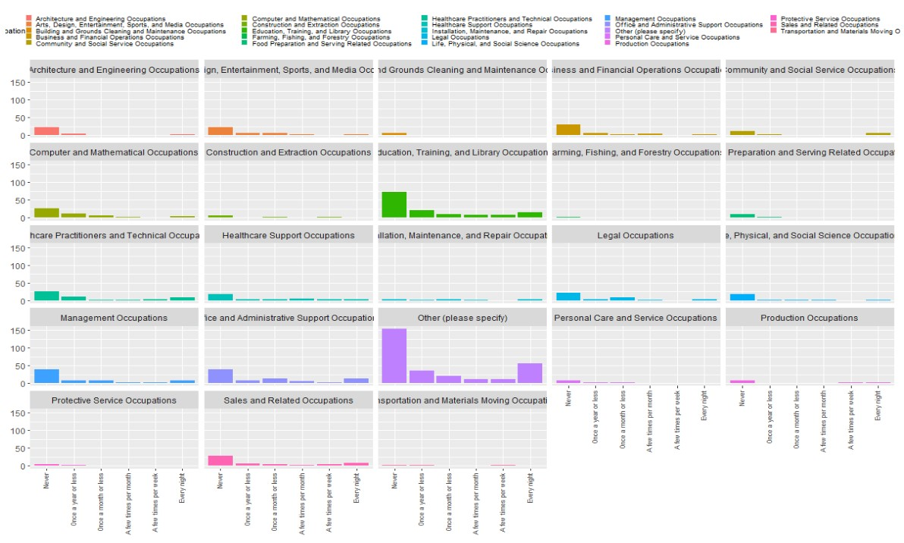

Slide 9
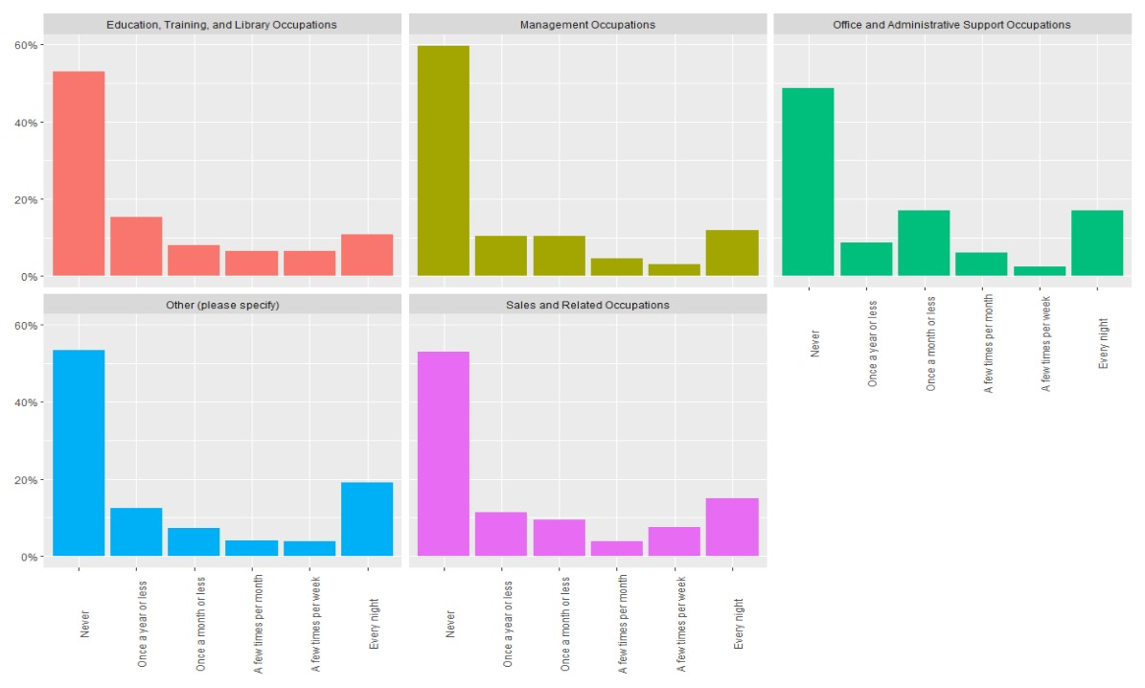

Slide 10
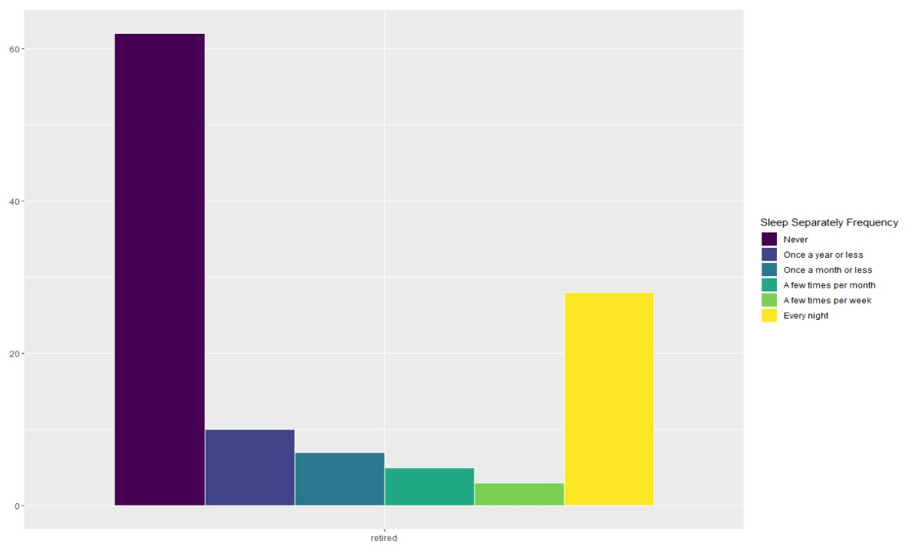

Slide 11
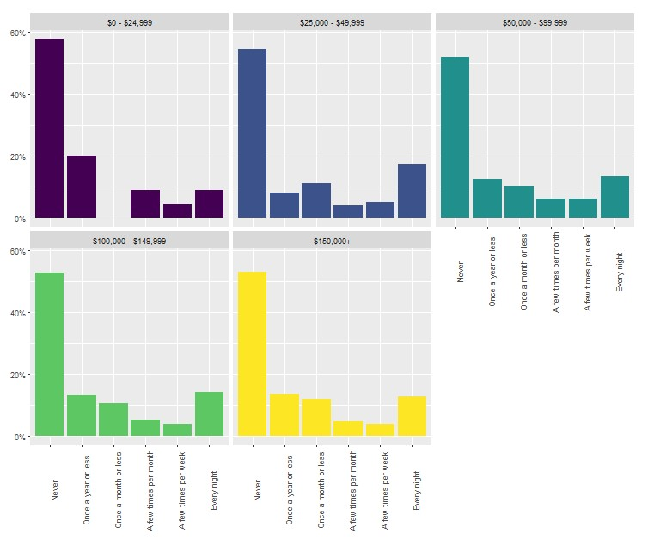

Slide 12
Frequency Sleeping Separately: Reasons for Sleeping
Separately

Slide 13
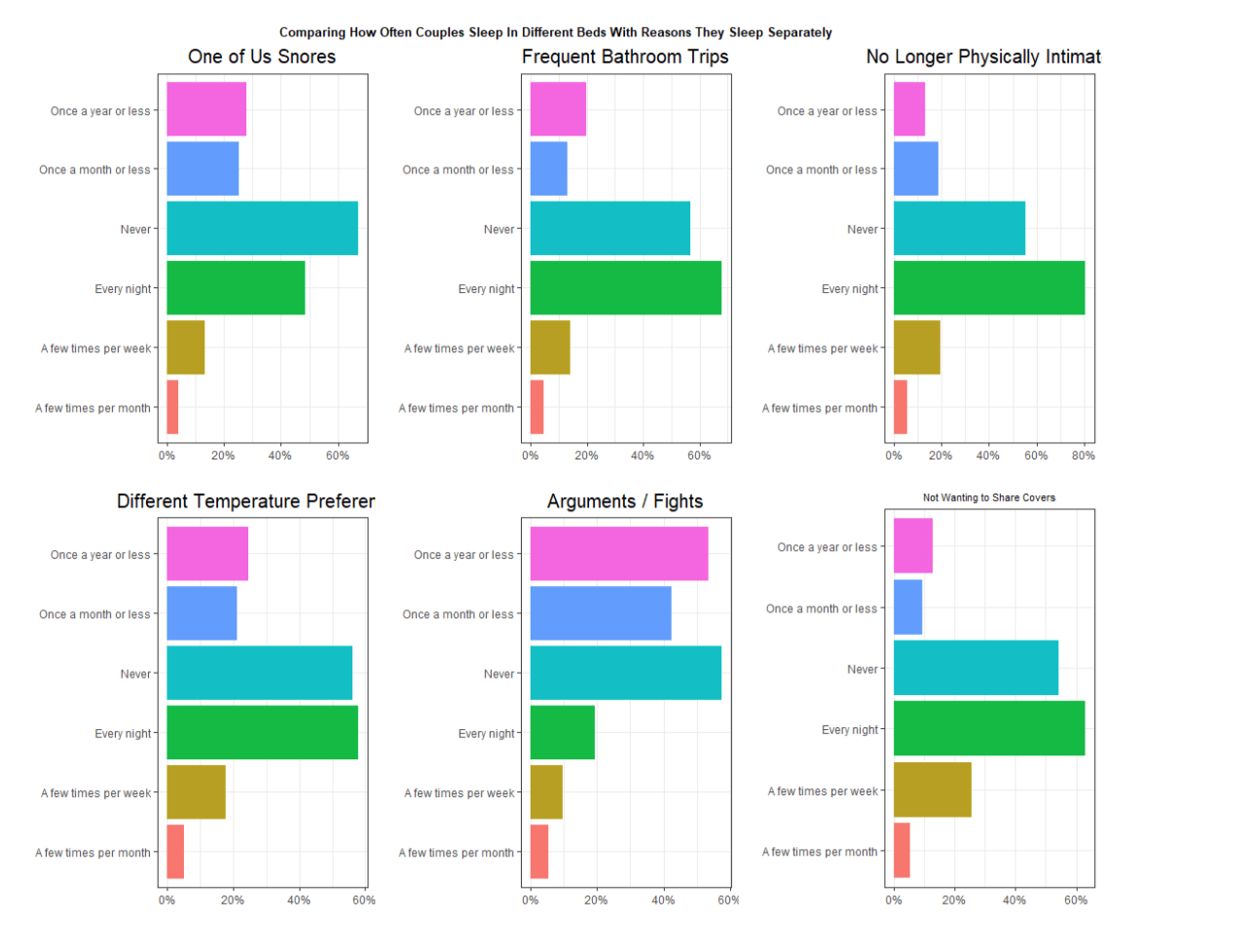

Slide 14
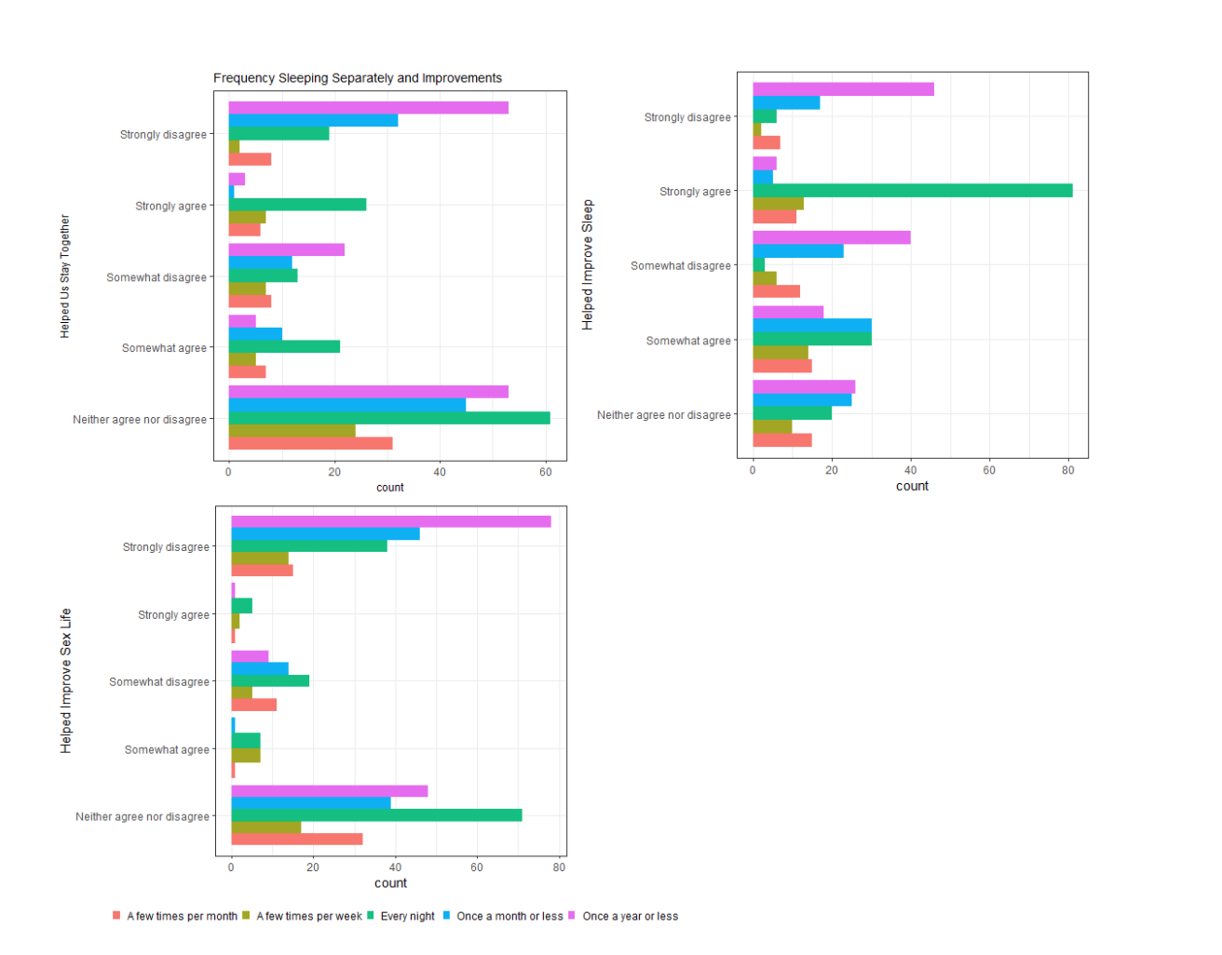

Slide 15
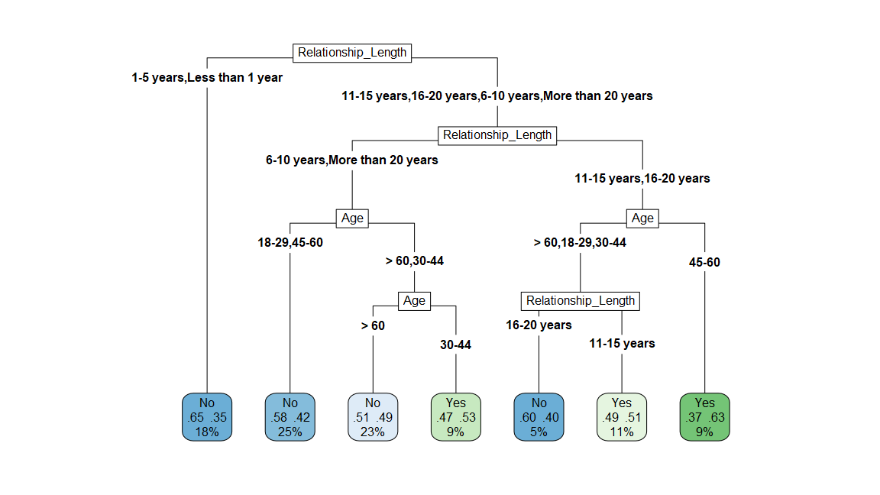
Machine Learning: Decision Tree

Slide 16
Observations, Recommendations
This data does align with the stereotypical patterns in our society regarding age / relationship length and sleeping situation.
That being that couples who are older (or have one partner who is older) and have been together longer are more likely to sleep separately
Reasons are highly related to comfort and to getting the best quality of sleep
But the stereotype of age / relationship length and separate sleeping usually has to do with stereotypes about "romance fading away" or things of the kind
However, the most popular reasons in general are far more specific and practical (temperature preferences, snoring, sharing covers)

